Slide 1
Bellman-Ford Algorithm

Slide 2
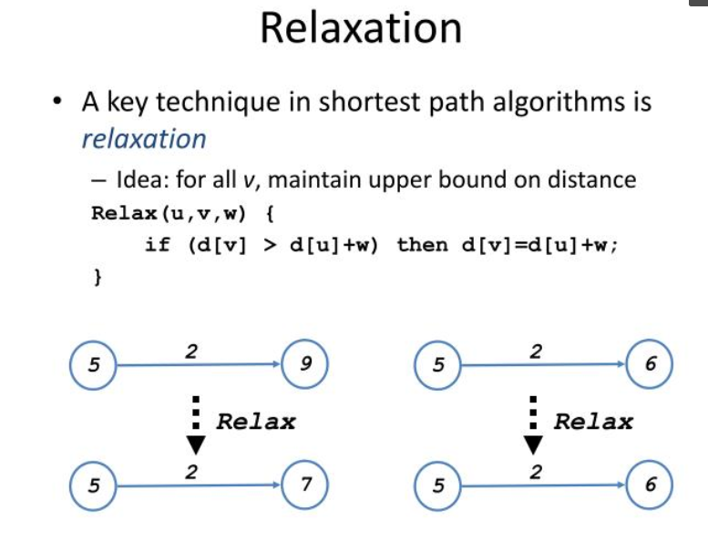

Slide 3
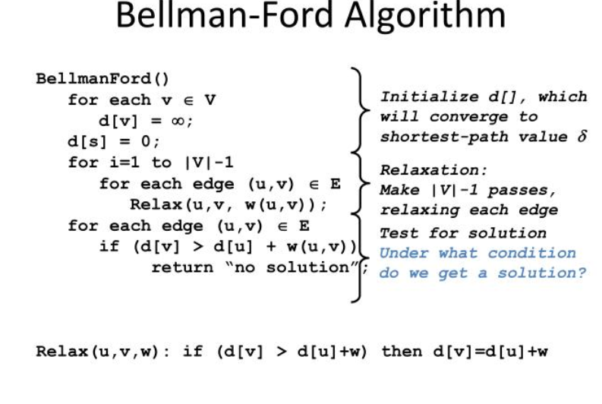

Slide 4
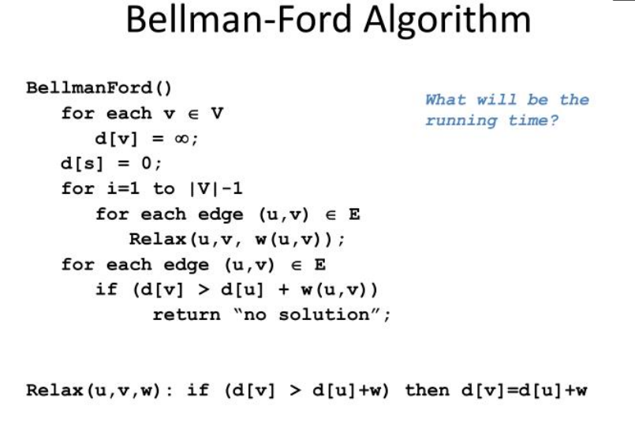

Slide 5
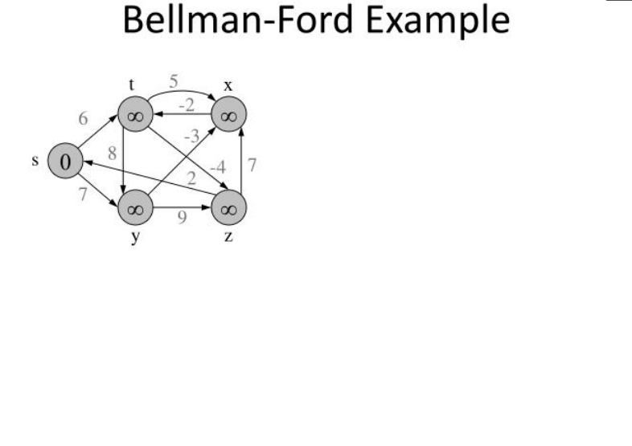

Slide 6
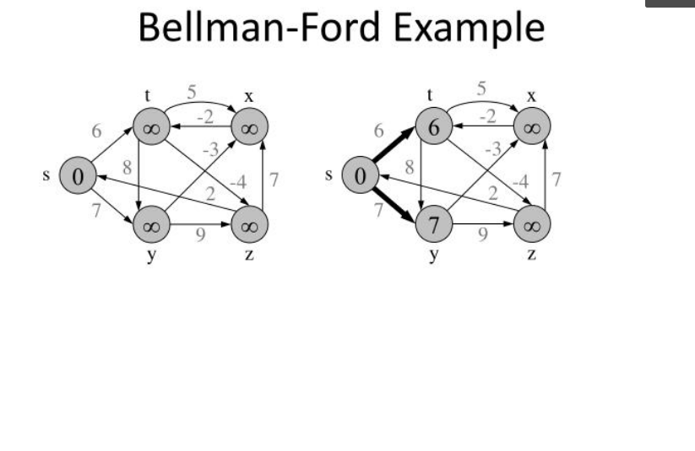

Slide 7
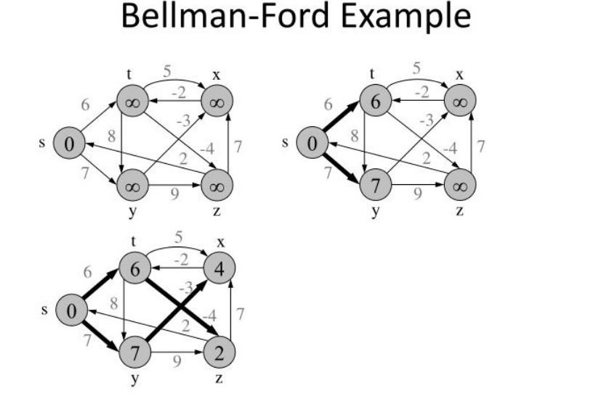

Slide 8
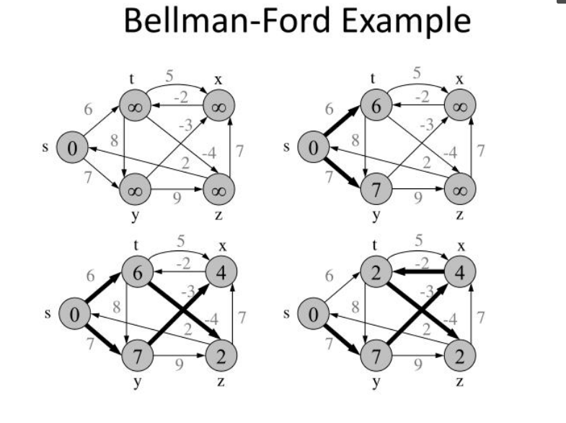

Slide 9
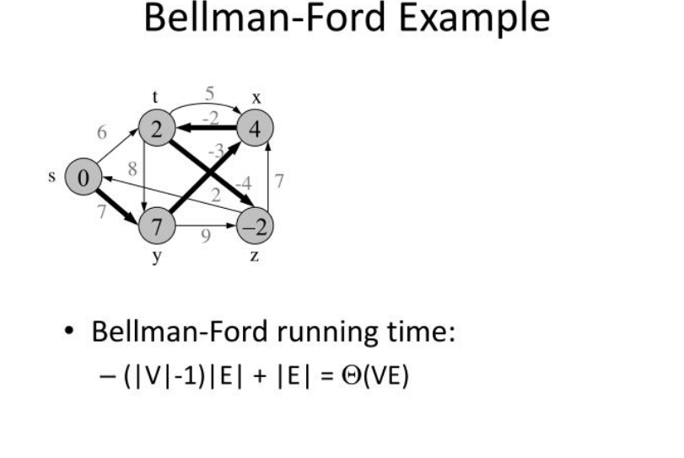

Slide 10
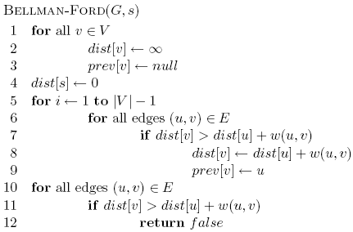
Bellman-Ford algorithm

Slide 11
Bellman-Ford algorithm
10
How many edges is the shortest path from s to:
S
A
8
1
G
-4
B
A:
2
1
1
-2
C
F
-1
3
E
D
-1

Slide 12
Bellman-Ford algorithm
10
How many edges is the shortest path from s to:
S
A
8
1
G
-4
B
A:
3
2
1
1
-2
C
F
-1
3
E
D
-1

Slide 13
Bellman-Ford algorithm
10
How many edges is the shortest path from s to:
S
A
8
1
G
-4
B
A:
3
2
1
1
-2
B:
F
C
-1
3
E
D
-1

Slide 14
Bellman-Ford algorithm
10
How many edges is the shortest path from s to:
S
A
8
1
G
-4
B
A:
3
2
1
1
-2
B:
5
F
C
-1
3
E
D
-1

Slide 15
Bellman-Ford algorithm
10
How many edges is the shortest path from s to:
S
A
8
1
G
-4
B
A:
3
2
1
1
-2
B:
5
F
C
-1
3
E
D
D:
-1

Slide 16
Bellman-Ford algorithm
10
How many edges is the shortest path from s to:
S
A
8
1
G
-4
B
A:
3
2
1
1
-2
B:
5
F
C
-1
3
E
D
D:
7
-1

Slide 17
Bellman-Ford algorithm
0
∞
10
S
A
Iteration: 0
8
1
∞
∞
G
-4
B
2
1
1
-2
C
∞
F
∞
-1
3
E
D
-1
∞
∞

Slide 18
Bellman-Ford algorithm
0
10
10
S
A
Iteration: 1
8
1
∞
8
G
-4
B
2
1
1
-2
C
∞
F
∞
-1
3
E
D
-1
∞
∞

Slide 19
Bellman-Ford algorithm
0
10
10
S
A
Iteration: 2
8
1
∞
8
G
-4
B
2
1
1
-2
C
∞
F
9
-1
3
E
D
-1
12
∞

Slide 20
Bellman-Ford algorithm
0
5
10
S
A
Iteration: 3
8
1
10
8
G
-4
B
A has the correct distance and path
2
1
1
-2
C
∞
F
9
-1
3
E
D
-1
8
∞

Slide 21
Bellman-Ford algorithm
0
5
10
S
A
Iteration: 4
8
1
6
8
G
-4
B
2
1
1
-2
C
11
F
9
-1
3
E
D
-1
7
∞

Slide 22
Bellman-Ford algorithm
0
5
10
S
A
Iteration: 5
8
1
5
8
G
-4
B
B has the correct distance and path
2
1
1
-2
C
7
F
9
-1
3
E
D
-1
7
14

Slide 23
Bellman-Ford algorithm
0
5
10
S
A
Iteration: 6
8
1
5
8
G
-4
B
2
1
1
-2
C
6
F
9
-1
3
E
D
-1
7
10

Slide 24
Bellman-Ford algorithm
0
5
10
S
A
Iteration: 7
8
1
5
8
G
-4
B
D (and all other nodes) have the correct distance and path
2
1
1
-2
C
6
F
9
-1
3
E
D
-1
7
9

